Slide 1
WISCares Veterinary Services
WesA
Adam, Chang, Dan, Robert, and Wesley

Slide 2

What is WisCares?
Veterinary Services
Social Work
Community Outreach
Notes:
Robert
-help homeless of dane county with pets, new org
Veterinary Medical
Walk-in clinics around the community targeting pets of those who are experiencing homelessness or in precarious housing situations.
Medical case management to help low-income individuals coordinate care for their pets using available and existing resources.
Social Work
Medical case management to help low-income individuals coordinate care for their pets using available and existing resources.
Help navigating access to and retention of housing for families or individuals with pets.
Community Outreach
Street outreach to improve access to pet food, safe pet supplies, and other resources for unsheltered homeless in the Dane County area.
New organization, created in 2012

Slide 3
Project Description
A database for pet medical history
A easy way for the user to get local resources for their pet.
Focused on the underserved population

Slide 4
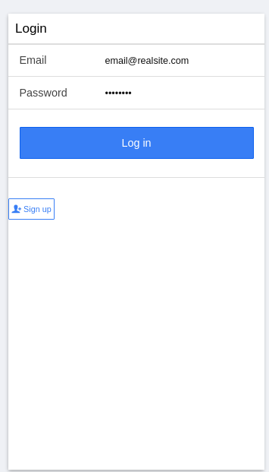
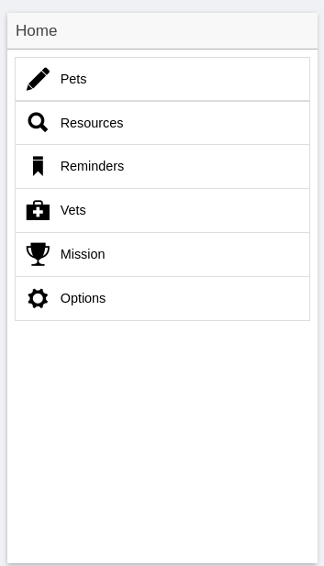
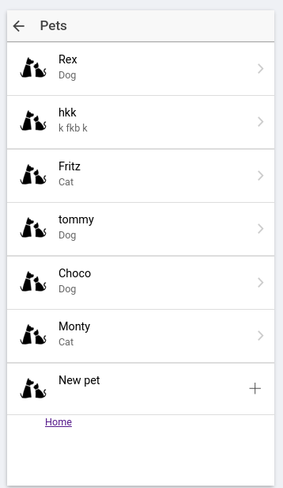
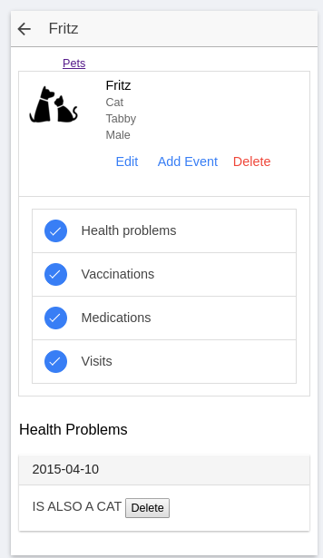
What we made

Slide 5
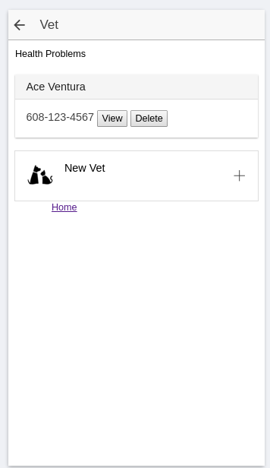
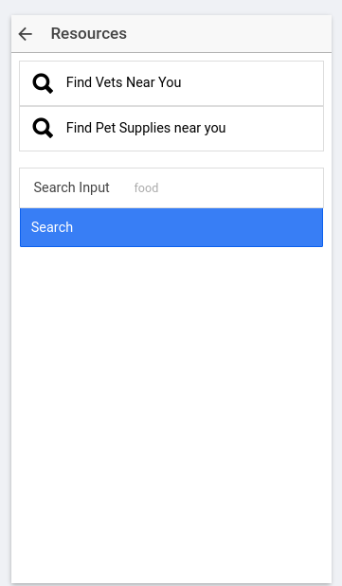
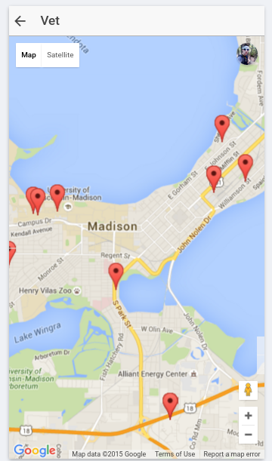


Slide 6
What’s coming up
Image handling between AngularJS and Paperclip gem
Needed for Pet profile images, images of documents
Necessary feature! Coming soon
User login features
Persistent login, logging out on demand, forced relog after a period of time
Also necessary! Just hasn’t been a focus yet
General looks improvement

Slide 7
Eyes were bigger than our stomachs
Things we dropped:
Offline access
Multi-lingual support
Time permitting:
Reminders
Website
Notes:
Wes: (2 minutes for next three slides)
Didn’t have time to implement all the features we originally planned on adding
We dropped offline support and made the application online only
We didn’t include multi-lingual support, only english
We have a couple features we still want to implement, but can be dropped if we don’t have enough time left
Reminders - Functionality for users to set reminders and get notifications
Website - Access to the application through a separate web site

Slide 8
Tools we used
Unit Testing
Jasmine, Karma, and Istanbul for AngularJS
Rspec and Simplecov for Rails
ngResource - Connecting AngularJS to Rails
Devise - Handling user registration/login
Google Maps API - Finding nearby resources
Paperclip - Image handling Rails side
Notes:
Wes
To unit test our angular JS code we used Jasmine to write the tests, Karma to run the tests, and Istanbul to measure code coverage
To connect our angularJS to Rails we used ngResource to send requests and receive responses. To test these we created Mocks of these resouces
To handle user registration and login we used Devise.
Google maps API was used to search for nearby resources
To handle images on rails we will be using Paperclip

Slide 9
Things that worked well
Slack/Google Hangouts - Team communication
Draw.io - Design documents
Amazon RDS/S3 and Heroku - Hosting
GitHub - Version control
Notes:
Wes
When we needed to communicate with the team while we were apart, we had a couple useful tools
Slack was a good message board to have discussions with the team
Google hangouts was a good way to have remote meetings
Amazon RDS and S3 were good tools for saving our data. We used RDS to create a postgresql database and S3 to store images submitted to the application
To let everyone on the team work on the code simultaneously and track changes, we used GitHub as our version control software

Slide 10
Difficulties we encountered
Creating an easily deployable product
Lots of tools to learn - Front End, Back End, Database
Unit testing was difficult to do late in the project
Finding times when everyone could meet
Windows Path Limit
Notes:
Robert
Creating script to install all dependencies correctly, some difficulties in building android apk
No prior experience with Rails, Ionic, very little experience with databases
Issues with adding new modules to the test
Wes - Some installed plugins (Karma) produced folders too deep to commit. Windows has a set file path limit and git couldn’t submit larger files. It also had a problem with installing some tools that used these large file limits. There was a git setting that could be changed to allow git to commit these files.
For getting around longpath issue in Windows use command
$ git config --system core.longpaths true
otherwise you can replace --system with --your_project_name

Slide 11
Lessons Learned
Unit testing - Start from first iteration
Iteration plans - More detail in design
Pair programming - Makes unforeseen difficulties less of a problem
Calendar - Meeting schedule
Intermediate deadlines - Prevents many last-minute features
Notes:
Robert
- Makes it easy to respond to issues, keeps the test suite working
- Time spent coordinating who specifically does what during each meeting
- Image difficulties may not have been an issue with pairs
- Makes scheduling much easier
- And is generally good practice

Slide 12
Google Maps API Integration Tutorial
Get your google API key
Get the map to show up using the Javascript calls
Use that API key to query the Google server for local results
Draw those results on the maps
Hope Angular does not hate you
Notes:
Assuming that you already have an app started

Slide 13
Google API key
Make it so..
https://developers.google.com/maps/signup?hl=en
Sign up for the google maps JS API key
So easy right?

Slide 14
Get your dependencies
Get your SASS on ( Syntactically Awesome Stylesheets Sass)
$: ionic setup sass
Add your platform --
$: ionic platform add ios / android
get ngCordova (for integrating native hardware calls into AngularJS)
$ bower install ngCordova

Slide 15
Does your App know where it is? Now it does.
add lines to your index.html so that the app will know where they are
<script src="lib/ngCordova/dist/ng-cordova.js"></script>
<script src="cordova.js"></script>
add this to app.js so that your app will load it.
angular.module('starter', ['ionic', 'ngCordova'])

Slide 16
Add the gravy Geolocation plugin from Cordova
$: cordova plugin and cordova-plugin-geolocation
Then Add the remote location of Google Maps JS SDK to your index file
<script src="js/app.js"></script>
<script src="http://maps.google.com/maps/api/js?key= YOUR_API_KEY_GOES_HERE&signed_in=true&libraries=places"> </script>

Slide 17
Add your new state
Add to State machine in app.js
.state('map', {
url: '/map',
templateUrl: 'templates/map.html',
controller: 'MapCtrl'
})

Slide 18
HTML for maps…..All you need is ..
Map.html
<ion-view view-title="Map-Title">>
<ion-content >
<div id="map" data-tap-disabled="true"></div>
</ion-content>
</ion-view>

Slide 19
The Code you have all been waiting for:
Add your controller to controllers.js
.controller('MapCtrl', function($scope, $state, $cordovaGeolocation) {
var options = {timeout: 10000, enableHighAccuracy: true};
$cordovaGeolocation.getCurrentPosition(options).then(function(position){
var latLng = new google.maps.LatLng(position.coords.latitude, position.coords.longitude);
var mapOptions = {
center: latLng,
zoom: 15,
mapTypeId: google.maps.MapTypeId.ROADMAP
};
$scope.map = new google.maps.Map(document.getElementById("map"), mapOptions);
}, function(error){
console.log("Could not get location");
});
});

Slide 20
The Code you have all been waiting for:
Add your controller to controllers.js
.controller('MapCtrl', function($scope, $state, $cordovaGeolocation) {
var options = {timeout: 10000, enableHighAccuracy: true};
$cordovaGeolocation.getCurrentPosition(options).then(function(position){
var latLng = new google.maps.LatLng(position.coords.latitude, position.coords.longitude);
var mapOptions = {
center: latLng,
zoom: 15,
mapTypeId: google.maps.MapTypeId.ROADMAP
};
$scope.map = new google.maps.Map(document.getElementById("map"), mapOptions);
}, function(error){
console.log("Could not get location");
});
});

Slide 21
You’re so SASSy
That SASS comes in handy in simplifying that CSS
open up your sass/ionic.app.scss file and add
.scroll {
height: 100%;
}
#map {
width: 100%;
height: 100%;
}
Notes:
This sets the map to use the entire screen space of the device.

Slide 22
Markers! We don’t need no stinking markers!
So you want a marker, then add to your controller after you get your map back:
google.maps.event.addListenerOnce($scope.map, 'idle', function(){
var marker = new google.maps.Marker({
map: $scope.map,
animation: google.maps.Animation.DROP,
position: latLng
});
var infoWindow = new google.maps.InfoWindow({
content: "We attack here at dawn!"
});
google.maps.event.addListener(marker, 'click', function () {
infoWindow.open($scope.map, marker);
});
});

Slide 23

AngularJS
A black box of awesome
A black box none the less.
dependency and scope issues
inconsistent code
Good news: Angular 2 is coming
Bad news: Angular 2 will not be backward compatible

